Slide 1
Database Languages (DML & TCL)

Slide 2
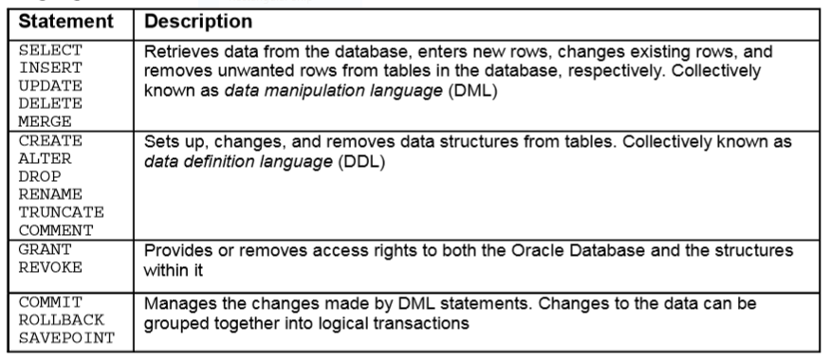
Database Languages

Slide 3
Data Manipulation Language (DML)
These commands are applied on data stored in a table.
Different DML commands are:
  Insert
  Update
  Delete
  Select
Select is also considered as a Data Query Language (DQL)

Slide 4
Select
To retrieve data from database we use selec command
Table name is used with FROM clause
Define condition with WHERE clause
To select all columns
  SELECT * FROM Persons WHERE P_ID <=5;
To select specific columns
  Select P_ID, Pname FROM Persons WHERE P_ID<=5;

Slide 5
Use of Operators
The arithmetic operators can be applied on number and date data types column.
Select name, salary , salary*12 from employees;
First * and / are processed.
Operators of same priority are processed from left to right.
Use parenthesis to force the expression to be evaluated first.

Slide 6
eg. Select name, 12 * salary + 100 from employees;
Select name, 12 * (salary+100) from employees;

Slide 7
Working with null values
Null is not blank space or zero.
Zero is a number.
Blank space is a character.
It is unavailable or unassigned value.
Any arithmetic operation with null is also resulted in null.
Select first_name, 12*commission_pct from employees;

Slide 8
Column Alias
Renames a column heading
Followed by column name
Require double quotes if alias contains space or special character or if it case-sensitive
Select name as N, dept d from employees;
Select lastname “Name”, salary*12 “Annual salary” from employees;

Slide 9
Concatenation
Link columns of character string with columns
Select lname || fname as “Ename” from employees;
If you are using a string it is called as literal character string
  Select lname || ‘ is a ’ || jobid as “Emp details” from employee;
To use a quote within string use this method:
  Select dname || q’[dept’s mgr id: ]’ || mgrid as “dept and mgr” from departments;
  Select column1 || ‘ any string ’ || column2 AS OUTPUT from table-name;

Slide 10
Distinct
To display unique values of a column
This will display all values of column deptid including duplicate values
  Select deptid from employees;
This will display only unique values of column deptid
  Select distinct deptid from employees;

Slide 11
Describe
To display the table structure
Desc tablename;
e.g. DESC Persons;

Slide 12
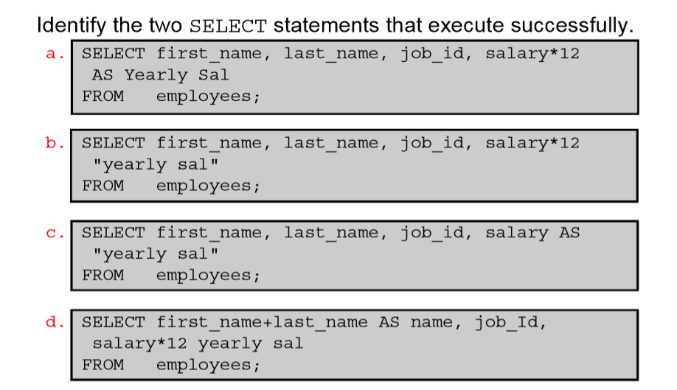
Question
Ans: b,c

Slide 13
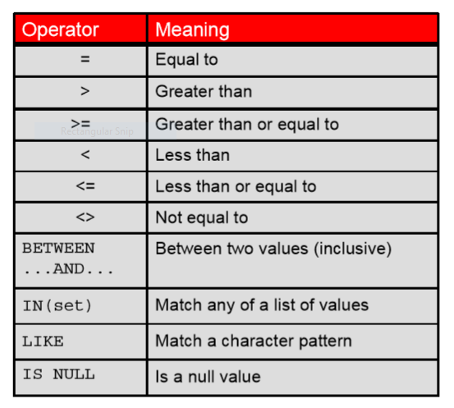
Comparison operators with WHERE

Slide 14
We can use numeric value or string in comparison condition with WHERE clause;
Select * from employees where employee_id>120;
Select employee_id, Last_name, salary from employees where employee_id>120;
Select employee_id, Last_name, salary from employees where job_id=‘IT_PROG’;
Select employee_id, Last_name, salary from employees where hire_date=’17-OCT-03’;

Slide 15
Using comparison operator
Select * from employees WHERE manager_id=124;
Select last_name from employees WHERE manager_id<130;
Select last_name from employees WHERE manager_id>=130;
Select last_name from employees WHERE job_id<>’ST_CLERK’;

Slide 16
Using Between
It defines a range of values according to which rows are selected
Syntax:
  Select col1, col2 from tablename where colname BETWEEN value1 AND value2;
  Value 1 is upper limit
  Value 2 is lower limit
  e.g. Select last_name, job_id from employees WHERE salary BETWEEN 9000 AND 12000;

Slide 17
Using IN
To define a set of values in a condition
Syntax:
  Select col1, col2 from employees WHERE colname IN (val1, val2,…);
e.g. select employee_id, salary, job_id from employees WHERE job_id IN (‘IT_PROG’, ‘ST_CLERK’);

Slide 18
Using LIKE
Performs the searching for literals character string or numbers
% denotes zero or more character
_ denotes one character.
To search for a value starting from “g” and ending with any character.
  e.g. select first_name from employees WHERE first_name LIKE ‘g%’;

Slide 19
To search for a value ending with “g” and starting with any character:
  Select * from employees WHERE first_name LIKE ‘%g’;
To search for a value have a substring in it:
  Select * from employees WHERE first_name LIKE ‘%and%’;

Slide 20
Wildcard character
Select * from emplyees WHERE job_id LIKE ‘_T%’;
It will search for the values with capital T as the second character in job_id column and first character could be anything.

Slide 21
Null in where condition
To select the rows that contains null value in the specified column:
Select * from employee where manager_id IS NULL;

Slide 22
Logical operators
AND (returns true if both condition are true)
OR (returns true if either condition is true)
NOT (returns true if condition is false)

Slide 23
AND, OR, NOT
Select * from employees where employee_id>120 AND job_id=‘ST_CLERK’;
Select * from employees where job_id=‘IT_PROG’ OR job_id=‘ST_CLERK’;
Select * from employees where job_id NOT IN(‘ST_CLERK’, ‘IT_PROG’);

Slide 24
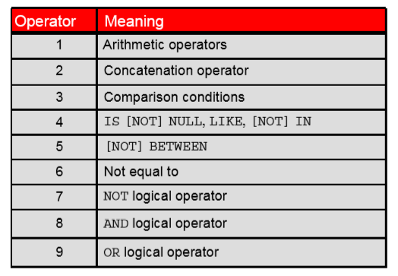
Order of precedence

Slide 25
In this query AND will be processed first followed by OR
Select * from employees where employee_id>120 OR job_id=‘ST_CLERK’ AND manager_id>120;
You can force the operator to be processed first by applying parenthesis as follows:
Select * from employees where employee_id>120 OR job_id=‘ST_CLERK’ AND manager_id>120;

Slide 26
Order By
It is used for sorting of rows
Two sorting orders:
ASC- ascending order
DESC- descending order
If you will not specify sorting order then by default ASC order is performed
Syntax:
  Select * from tablename ORDER BY col SORT_ORDER;
  Select * from tablename where condition ORDER BY col SORT_ORDER;

Slide 27
e.g Select * from employees ORDER BY first_name;
Select * from employees ORDER BY first_name ASC;
Select * from employees where manager_id>150 ORDER BY manager_id;
Select * from employees where manager_id>150 ORDER BY manager_id DESC;

Slide 28
Row limiting clause
Select col1, col2, from table name FETCH FIRST 10 ROWS ONLY;
Select col1, col2, from table name OFFSET 5 ROWS FETCH NEXT 10 ROWS ONLY;
Select col1, col2, from table name ORDER BY col1 FETCH FIRST 10 ROWS ONLY;
Select col1, col2, from table name ORDER BY col1 OFFSET 5 ROWS FETCH NEXT 10 ROWS ONLY;

Slide 29
Substitution variable
Temporarily store values with single ampersand (&) and double ampersand (&&)
Used in:--
Where condition
Order by
Column expression
Table names
Entire select statement

Slide 30
Single-ampersand
Select * from table_name where employee_id = &employee_num;
Select * from table_name where job_id = &job_title;
select first_name, &col_name from employees where &condition order by &order_col_name;

Slide 31
Double-ampersand
It is used if you want the variable value without prompting the user each time.
select first_name, &&col_name from employees order by &order_col_name;

Slide 32
Define and Undefine
Define is used to initialize a value
DEFINE job_id=‘IT_PROG’
  Select * from employees where job_id=&job_title;
Use undefine to remove the variable
UNDEFINE job_id

Slide 33
VERIFY
Set verify ON
  Select * from employees where employee_id=&employee_id;
It will display the format of query old and new
That means before asking for input and after asking for input.

Slide 34
INSERT
Insert (It is user to insert data rows in table)
Insert into employees column(employee_id, first_name, email) values(1, ‘abc’, ‘xyz’);
Insert into employees values(1, ‘abc’, ‘xyz’, ‘d’, ….);
Column list is optional

Slide 35
UPDATE
It is used to change any existing value
This query will set email value as mymail for all of the rows in table:
  Update employees set email=‘mymail’
To update only one row where emp id is 203:
  Update employees set email=‘mymail’ where employee_id=203
It will change two columns:
  Update employees set email=‘mymail’, job_id=‘dba’ where employee_id=203;

Slide 36
DELETE
To delete all rows from a table:
  Delete from employees;
To delete selected rows:
  Delete from employees where employee_id=224

Slide 37
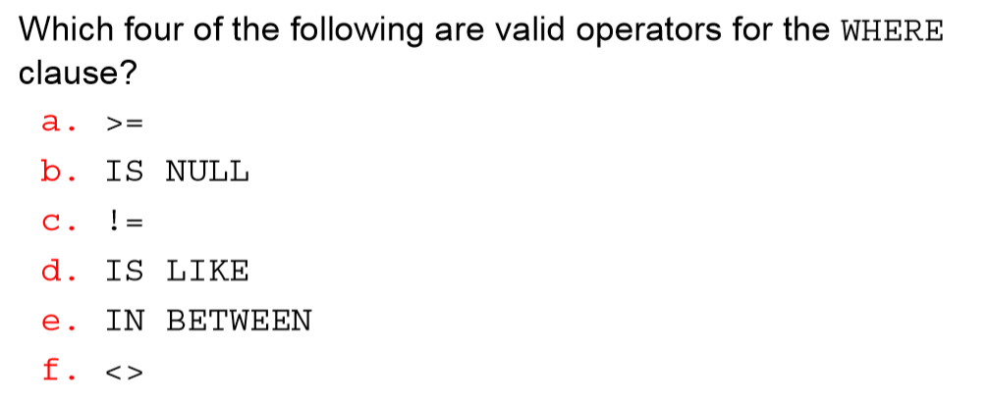
Question
Ans: a, b, c, f

Slide 38
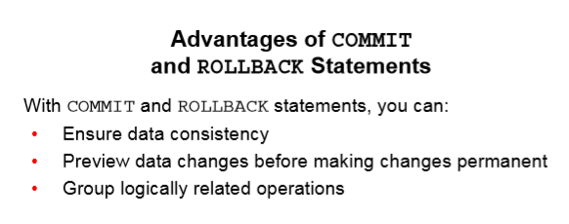
Transaction Control Language (TCL)
Commit
Savepoint
Rollback

Slide 39
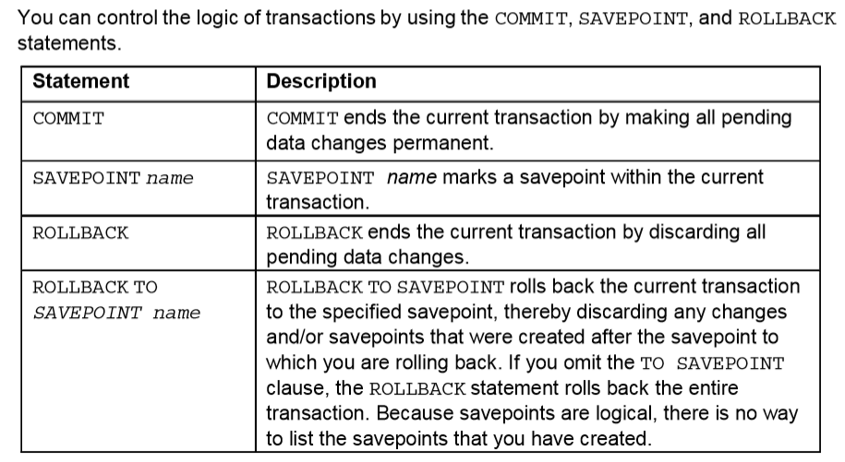

Slide 40
Transaction once committed cannot be rollback
  Commit;
Create savepoint at intermediate state of database. It is helpful in rollback to a state which you saved as savepoint in case of any fault
  Savepoint savepoint_name;
Go to initial state of database:
  Rollback;
Go to a saved intermediate state of database;
  Rollback TO savepoint_name;

